Slide 1
Advanced CSS
Week 2 Session2

Slide 2
Contents of This session
CSS 3
Animation
Transition
Transform

Slide 3
CSS Animation
The CSS Animations module allows authors to create real, honest-to-goodness keyframe animation
keyframe animation allows you to explicitly specify other states at points along the way
Those “points along the way” are established by keyframes that define the beginning or end of a segment of animation

Slide 4
The Building Blocks of Animations
Keyframes - define the stages and styles of the animation.
Animation Properties - assign the @keyframes to a specific CSS element and define how it is animated.
Syntax:
@keyframes animation-name {
keyframe { property: value; }
keyframe { property: value; }
}

Slide 5
Building Block #1: Keyframes
Name of the animation: A name that describes the animation, for example, bounceIn.
Stages of the animation: Each stage of the animation is represented as a percentage. 0% represents the beginning state of the animation. 100% represents the ending state of the animation. Multiple intermediate states can be added in between.
CSS Properties: The CSS properties defined for each stage of the animation timeline.

Slide 6
Example 1
/* The animation code */ @keyframes exampleA { from { background-color: red; } to { background-color: yellow; } } /* The element to apply the animation to */ div { width: 100px; height: 100px; background-color: red; animation-name: exampleA; animation-duration: 4s; }

Slide 7
CSS Animation: keyframes
Example B of Keyframes
@keyframes exampleB {
0% { background-color: red; }
20% { background-color: orange; }
40% { background-color: yellow; }
60% { background-color: green; }
80% { background-color: blue; }
100% { background-color: purple; }
}
simplistic set of keyframes that changes the background color of an element over time

Slide 8
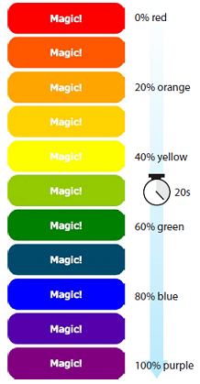
CSS Animation: keyframes
Example of Keyframes
@keyframes colors {
0% { background-color: red; }
20% { background-color: orange; }
40% { background-color: yellow; }
60% { background-color: green; }
80% { background-color: blue; }
100% { background-color: purple; }
}
simplistic set of keyframes that changes the background color of an element over time

Slide 9
CSS Animation: Applying Animation
Now we can apply this animation sequence to an element or multiple elements in the document using a collection of animation properties
We can make some decisions about the animation we want to apply:
Which animation to use (animation-name)
How long it should take (animation-duration)
The manner in which it should accelerate (animation-timing-function)
Whether to pause before it starts (animation-delay)

Slide 10
CSS Animation: Applying Animation (con.)
There are a few other animation-specific properties as well:
How many times it should repeat (animation-iteration-count).
Whether it plays forward, in reverse, or alternates back and forth (animation-direction)
Whether it should be running or paused. The play-state can be toggled on and off with JavaScript or on hover (animation-play-state).
Whether to override defaults that prevent properties from applying outside runtime (animation-fill-mode)

Slide 11
CSS Animation: Applying Animation (con.)
Here is the resulting rule for the animated element
#magic {
…
animation-name: colors;
animation-duration: 5s;
animation-timing-function: linear;
animation-iteration-count: infinite;
animation-direction: alternate;
}
Let have a look at our demos

Slide 12
CSS Transitions
Picture in your mind, if you will, a link in a navigation menu that changes from blue to red when the mouse hovers over it.
The background is blue… mouse passes over it…BAM! Red!
Now imagine putting your mouse over the link and the background gradually changes from blue to red, passing through several shades of purple on the way. It’s smoooooth.
That’s what CSS Transitions do.

Slide 13
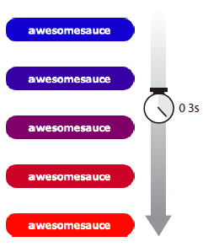
CSS Transitions
When applying a transition, there are a few decisions to make, each of which is set with a CSS property:
Which CSS property to change (transition-property)
How long it should take (transition-duration)
The manner in which the transition accelerates (transition-timingfunction)
Whether there should be a pause before it starts (transition-delay)
Illustration of Transition

Slide 14
CSS Transitions : transition-property
specifies the name of the CSS property the transition effect is for
transition-property
Values: property-name | all | none
Default: all
Example
transition-property: width;
This means that you want to apply a transition to width property

Slide 15
CSS Transitions : transition-duration
specifies how many seconds (s) or milliseconds (ms) a transition effect takes to complete
transition-duration
Values: time
Default: 0s
Example
transition-duration: 5s;
5s to complete the transition

Slide 16
Example 1
Example 1- version 2
div {
width: 100px;
height: 100px;
background: red;
-webkit-transition-property: width; /* Safari */
-webkit-transition-duration: 5s; /* Safari */
transition-property: width;
transition-duration: 5s;
}
div:hover {
width: 300px;
}
div {
width: 100px;
height: 100px;
background: red;
-webkit-transition: width 5s; /* For Safari 3.1 to 6.0 */
transition: width 5s;
}
div:hover {
width: 300px;
}

Slide 17
CSS Transitions : transition-timing-function
specifies the speed curve of the transition effect
transition-timing-function
Values: ease | linear | ease-in | ease-out |
ease-in-out | step-start | step-end | steps
Default: ease
Example
transition-timing-function: ease-out
This means the transition will starts out fast, then slows down

Slide 18
CSS Transitions : transition-delay
specifies when the transition effect will start
transition-delay
Values: time
Default: 0s
Example
transition-delay: 2s
This means the transition will starts after 2 seconds
Now, The demo time !!

Slide 19
CSS Transforms
The CSS3 Transforms module gives authors a way to rotate, relocate, resize, and skew HTML elements in both two- and three-dimensional space
We focus on the more straightforward 2-D varieties because they have more practical use

Slide 20
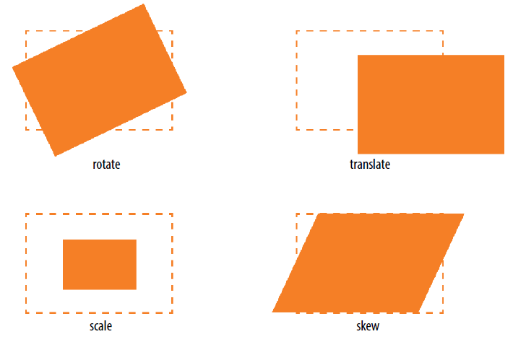
CSS Transforms
Four types of transformation

Slide 21
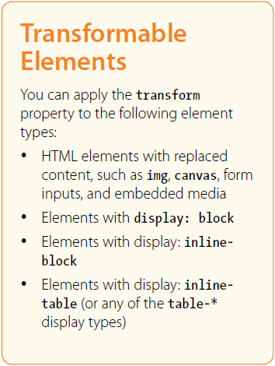
CSS Transforms
allow you to translate, rotate, scale, and skew elements
transform
Values: transform function(s) | none
Default: none
Example
transform: translate(50px,100px);
We call a translate function to perform a transformation
More details on transform functions in the following slides

Slide 22
CSS Transforms : rotate
Defines a 2D rotation, the angle is specified in the parameter
transform: rotate(angle)
Example
img {
width: 300px;
height: 400px;
transform: rotate(-10deg);
}
Rotating an img element using transform: rotate().

Slide 23
CSS Transforms : transform-origin
Notice that the image rotates around its center point, which is the default point around which all transformations happen. But you can change that
transform-origin
Values: percentage | length | left | center |
right | top | bottom
Default: 50% 50%
Example
a img { transform-origin: center top;}
a img { transform-origin: 50%, 0%;}
a img { transform-origin: 150px, 0;}
img element rotated at the center point

Slide 24
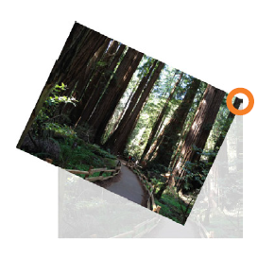
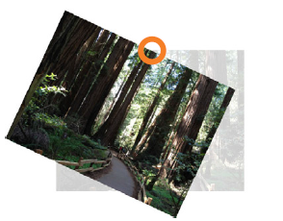
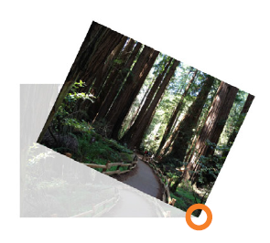
CSS Transforms : transform-origin
The following images have all been rotated 25 degrees, but from different origin points
transform-origin: center top;
transform-origin: 100% 100%;
transform-origin: 400px 0;

Slide 25
CSS Transforms : translate
moves an element from its current position (according to the parameters given for the X-axis and the Y-axis)
transform: translate(x,y)
transform: translateX(x);
transform: translateY(y);
Example
a img { transform: translate(90px, 60px);} (1st image)
a img { transform: translate(-5%, -25%); }(2nd image)

Slide 26
CSS Transforms : scale
increases or decreases the size of an element (according to the parameters given for the width and height)
scale(x,y)
scaleX(n)
scaleY(n)
Example
a img { transform: scale(1.25);}
a img { transform: scale(.75);}
a img { transform: scale(1.5, .5);}

Slide 27
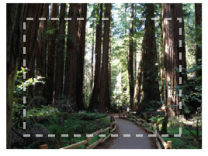
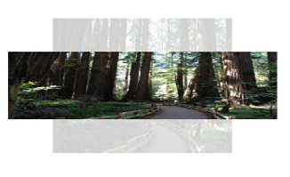
CSS Transforms : scale
Example of Scale function in transformation
transform: scale(1.25);
transform: scale(.75);
transform: scale(1.5, .5);

Slide 28
CSS Transforms : skew
skews an element along the X and/or Y-axis by the given angles
skew(x-angle,y-angle)
skewX(angle)
skewY(angle)
Example
a img {transform: skewX(15deg);}
a img {transform: skewY(30deg);}
a img {transform: skew(15deg, 30deg);}

Slide 29
CSS Transforms : skew
Example of Skew function in transformation
transform: skewX(15deg);
transform: skewY(30deg);
transform: skew(15deg, 30deg);

Slide 30
CSS 3D Transforms
In addition, the CSS Transforms spec also describes a system for creating a sense of space and perspective.
Combined with transitions, you can use 3-D transforms to create rich interactive interfaces
such as image carousels, flippable cards, or spinning cubes
Demo: 3d spinning cube!!

Slide 31
Exercise
CSS3 transition, transformation, animation

Slide 32
References
https://www.w3schools.com/

